Slide 1
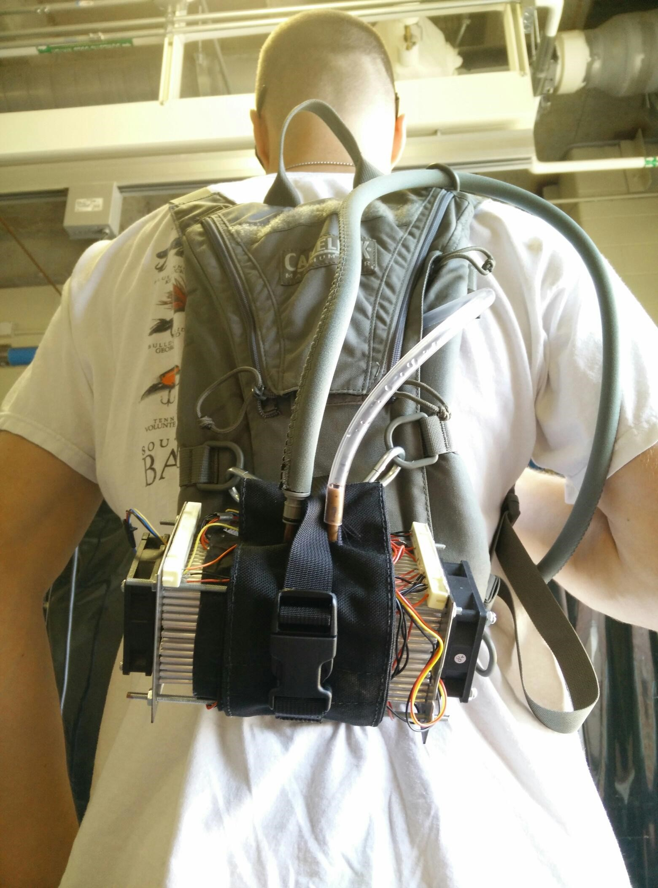

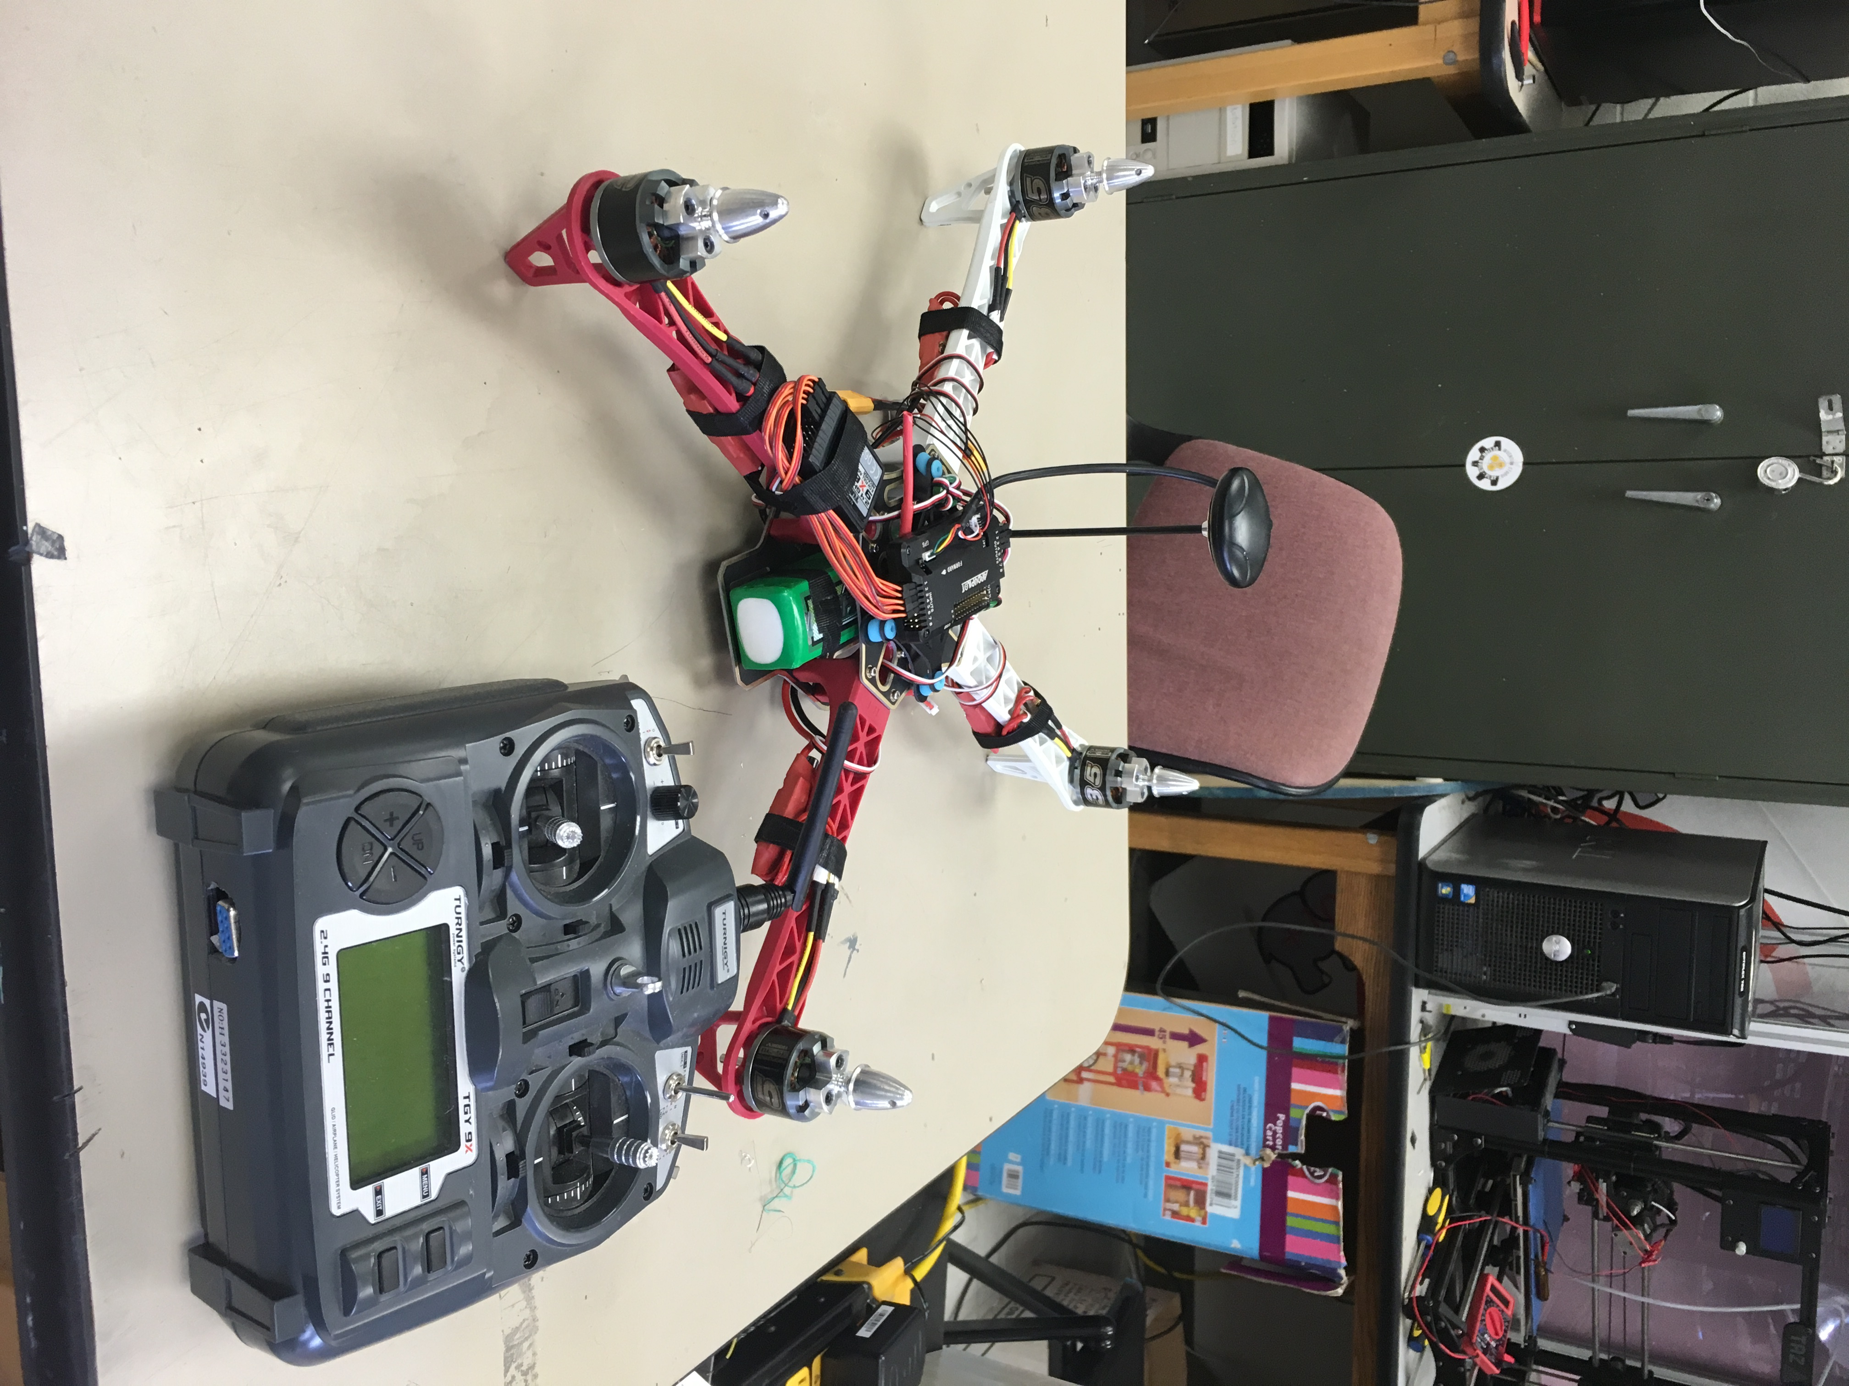
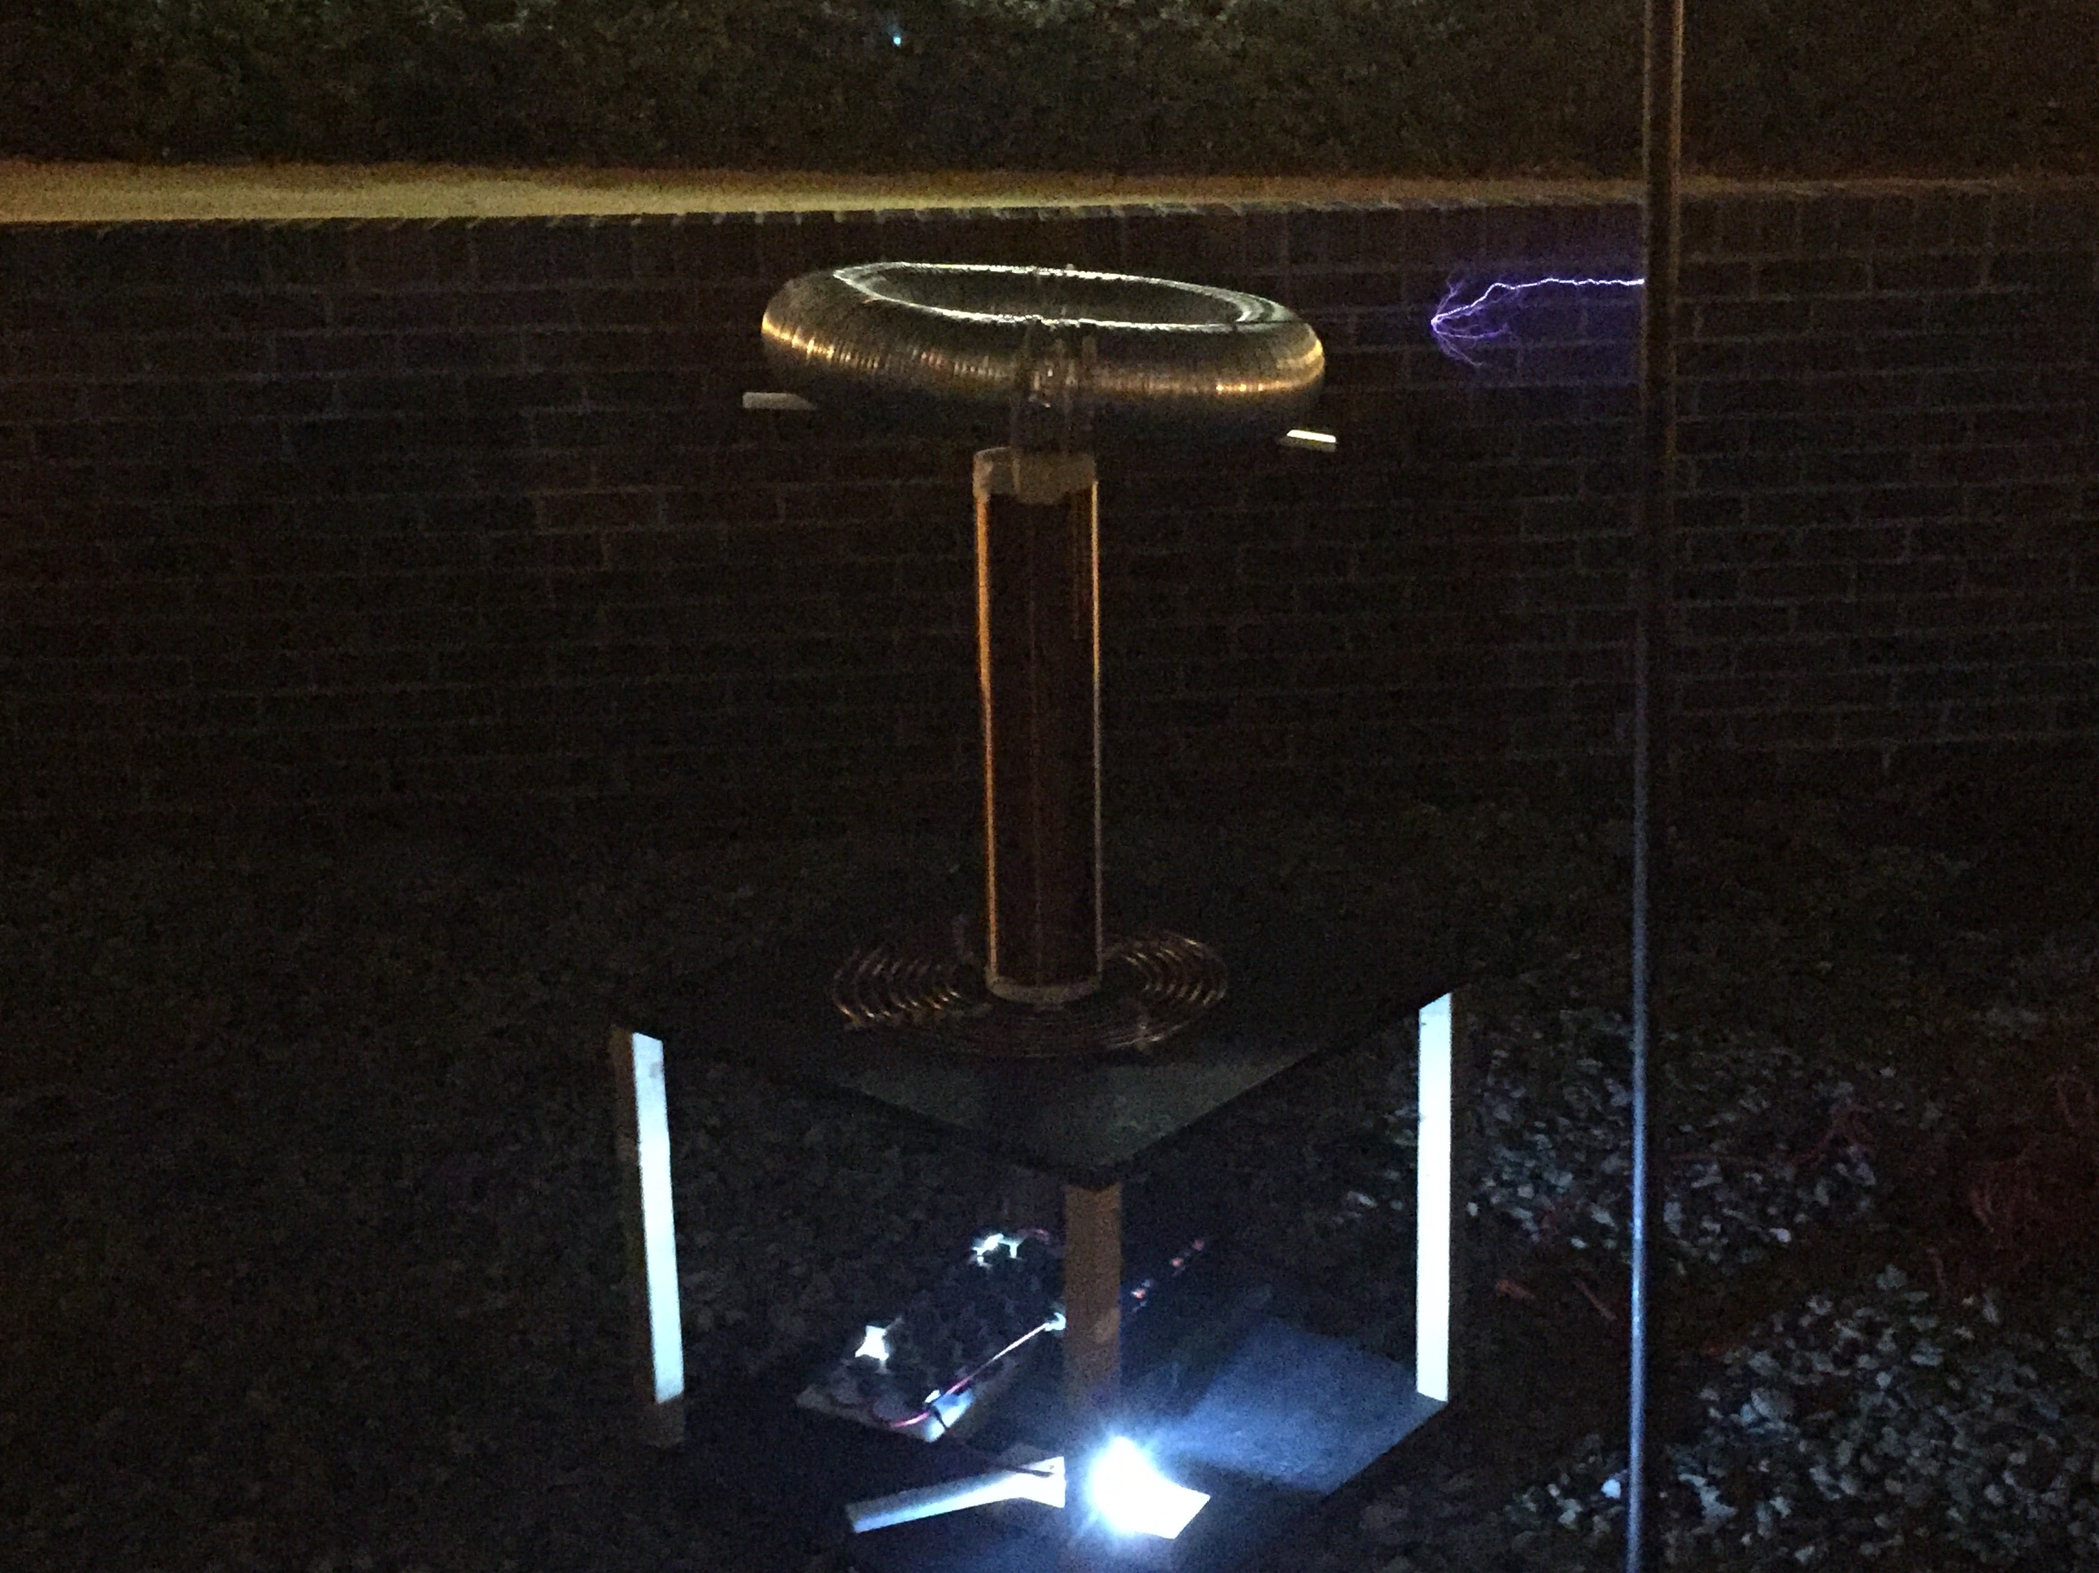
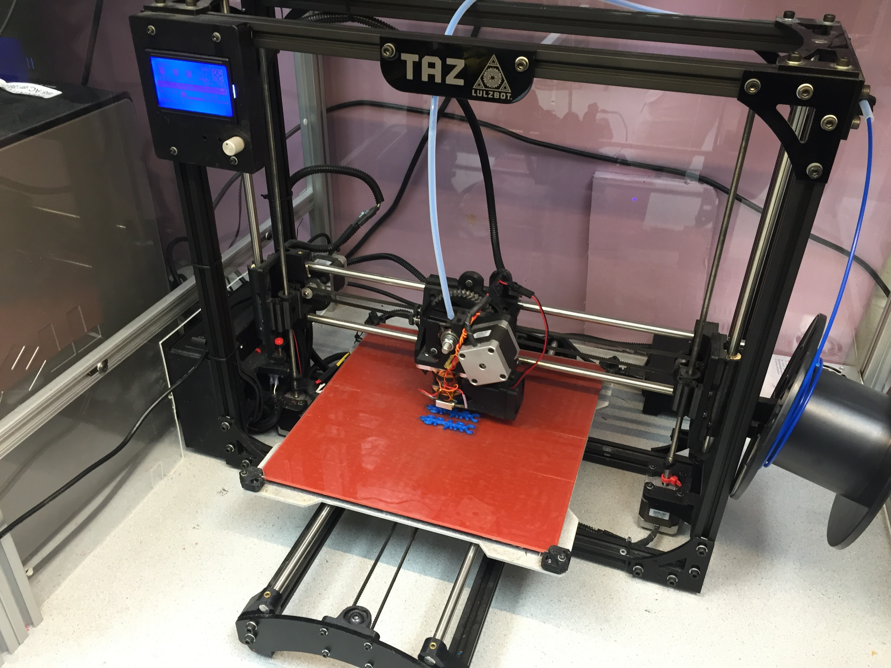
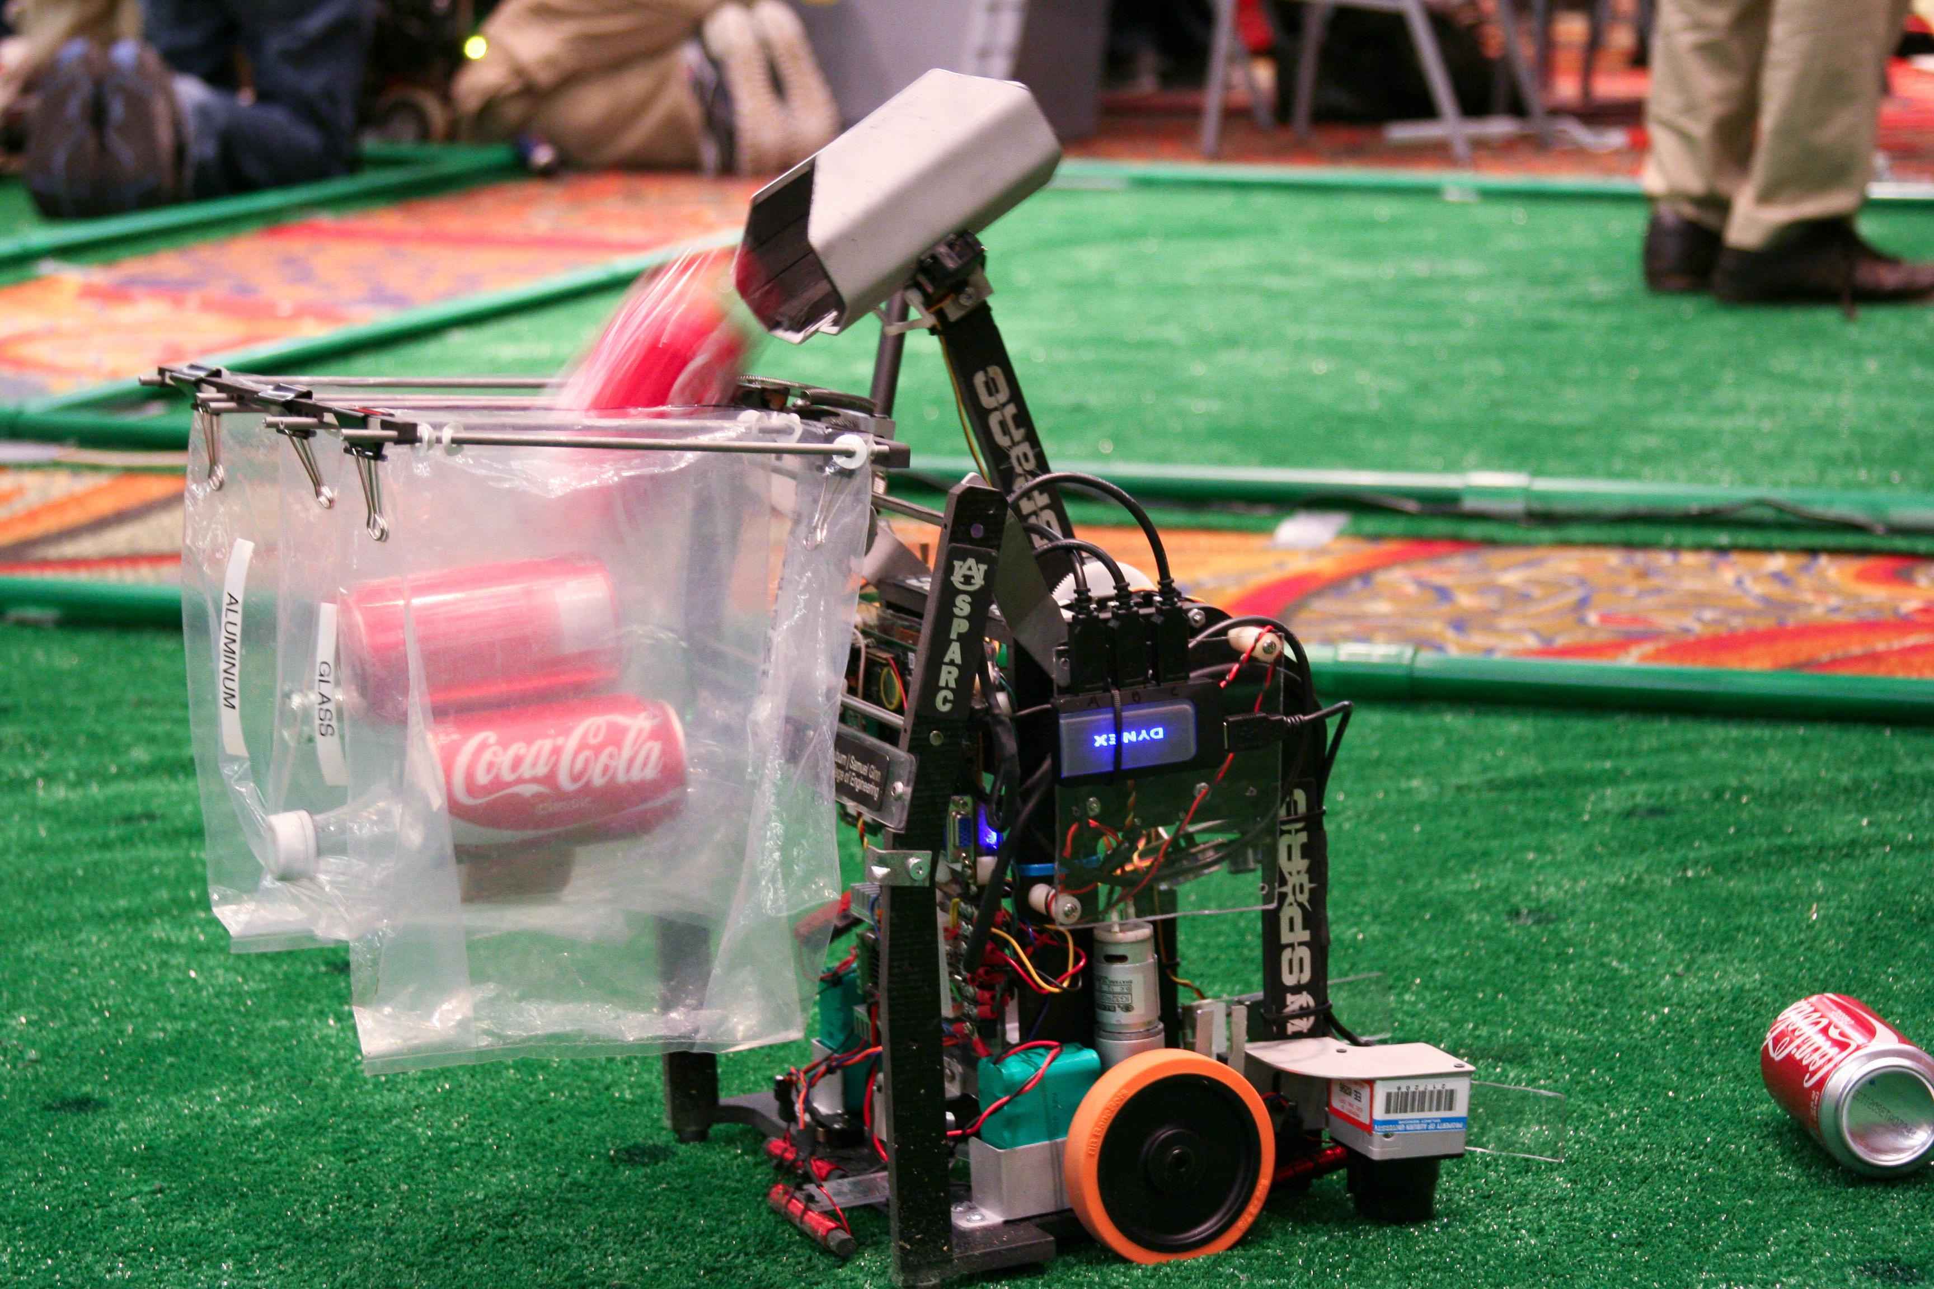
Looking for hands-on project experience?
Collaborative learning environment
Circuit Design
3D printing
Robotics
CAD
And more!
No past experience required
Come join us:
Spring 2018 Weekly Meetings:
Open Forum
Tuesdays 6-7, Broun 235
Maker Training Sessions
Wednesdays 5-6, Broun 235
Lab Location:
Broun Hall 367
Website
http://sparc-auburn.github.io/
Email
sparc.auburn@gmail.com
Slack
https://sparc-auburn.slack.com/

